Slide 1
Swarm robot
PREPARED BY: MUHAMMAD GHAZALI BIN RAMLY

Slide 2
HISTORY

Slide 3
HISTORY OF SWARM ROBOT
The term ’swarm’ in the context of robotics is applied for the first time by G. Beni and Fukuda in 1988. According to G. Beni, cellular robotics is a system composed of autonomous robots, that operate in a n-dimensional cellular space, without any central entity. Additionally, they have limited communication among themselves, and they coordinate and cooperate to accomplish common goals.
On the other hand, Fukuda uses swarm as a group of robots that can work together like the cells of a human body and as a result, they can accomplish complex goals. One year later G. Beni and J. Wang introduces the term of swarm intelligence in relation to cellar robotic systems . They claimed that cellular robotic systems are able to show ’intelligent’ behavior via coordinating their actions.
In 1993, C. Ronald Kube and Hong Zohng constructed a multi-robot system that was inspired by the collective behaviors of natural swarms. At the same year, Gregory Dudek define swarm robotics with respect to different features, including the size of a swarm, communication range amongst the robots in a swarm, communication topology, communication bandwidth, reorganization rate of a swarm, abilities of swarm members and swarm homo- or heterogeneity.

Slide 4
According to the authors ’swarm’ is a synonym to multirobot systems, which is why it was still not clear what properties differ the term ’swarm robotics’ from other robotic systems. In the early research on swarm robotic systems, the focus remained on the explorations of swarming behaviors in different species, like ants, birds, fish, and others. The researchers examined these behaviors and explored ways on how to realize these behaviors in robotic systems.
Additionally, research were driven by different inspirations, like the flocking of birds or colonies of ants. Natural swarms have always been the main motivation behind the idea of swarm robotics. Many studies and researches emulate different swarming behaviors like foraging, flocking, sorting, stigmergy, or cooperation and are two very old research works, that deal with the topic of stigmergy. Stigmergy refers to the indirect communication amongst species and is introduced by [20] with reference to the behavior of termites. The first paper illustrates several experiments where mobile robots are responsible for collecting randomly distributed objects in an environment via stigmergy. explores the feature of stigmergy and self organization amongst robots, having the same capabilities.

Slide 5
BASIC SYSTEM ARCHICTECTURE

Slide 6
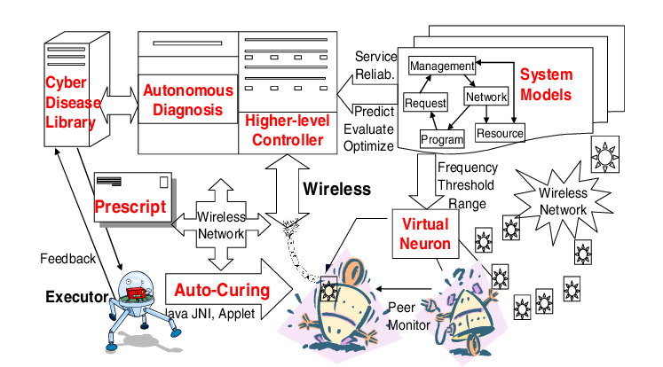
BASIC SYSTEM ARCHITECTURE

Slide 7
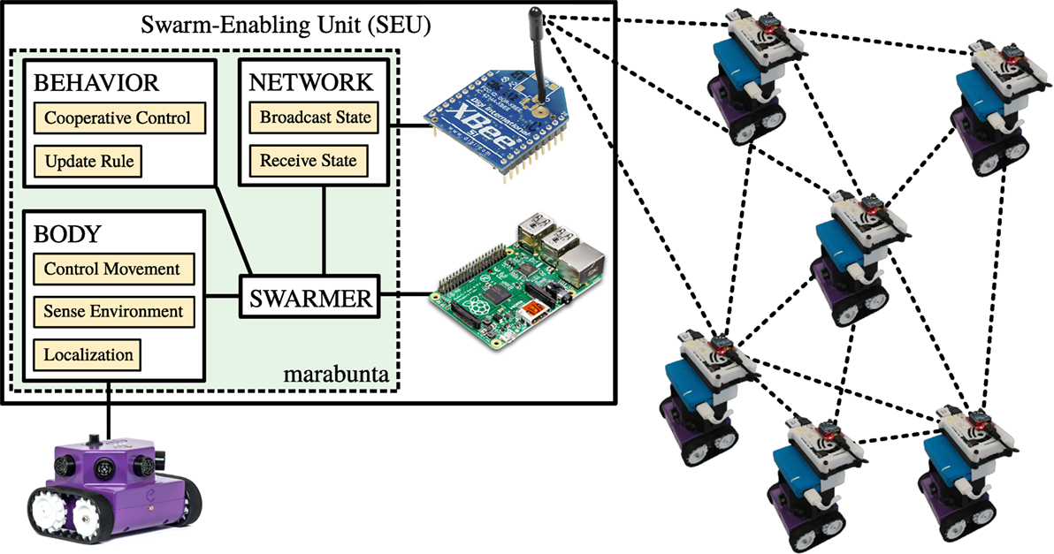
BASIC SYSTEM ARCHITECTURE

Slide 8
ROBOT DESIGN VS TASK

Slide 9

ROBOT DESIGN VS TASK
The Crazyswarm is a swarm of miniature quadcopters (Crazyflie 2.0) that can fly together in close proximity. Our approach has the goal to make research in multi-robot systems safer, cheaper, and easier to reproduce. The Crazyswarm has the following features (amongst others):
Safe operation near humans
Small footprint allows to fly many vehicles in small lab spaces
Good crash resistance because of low inertia
Fully open-source
Off-the-shelf hardware
The system currently requires a motion capture system (e.g., VICON, OptiTrack, or PhaseSpace).
The Automatic Coordination of Teams (ACT) Lab is part of the Robotics and Autonomous Systems Center (RASC) at USC. ACT Lab conducts research in the area of coordinated multi-robot systems. The common theme behind our different research threads is that we provide theoretically sound solutions to practically motivated problems.

Slide 10

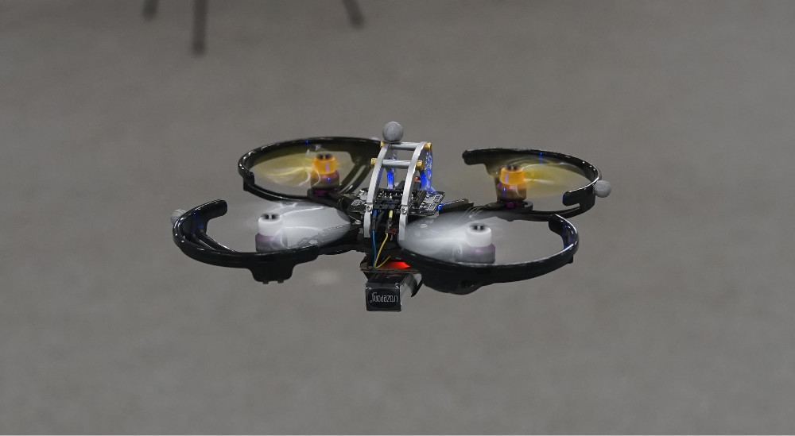
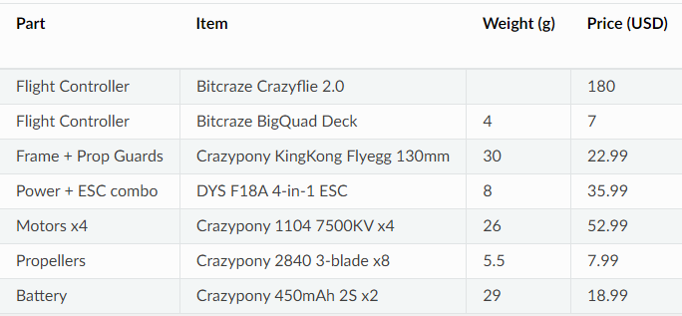

Slide 11

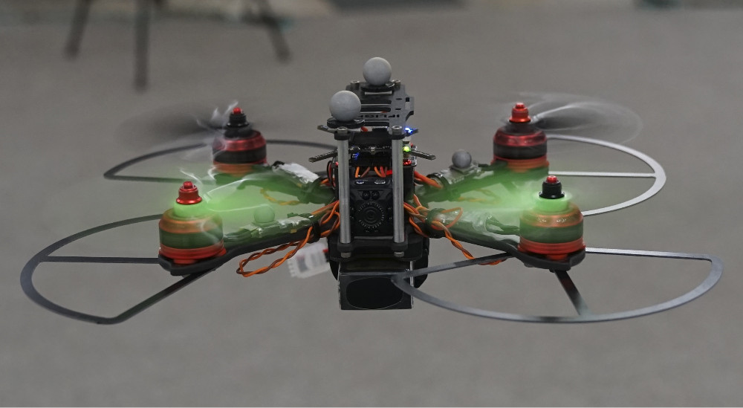


Slide 12
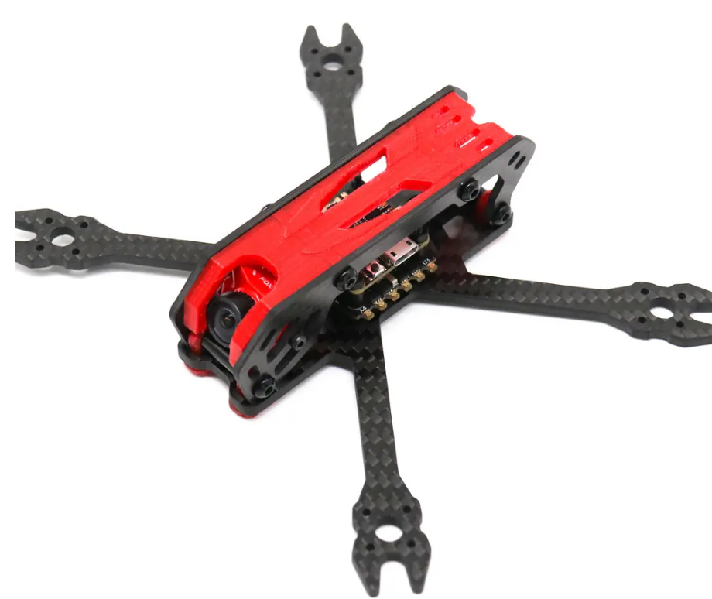


1. FRAME

Slide 13
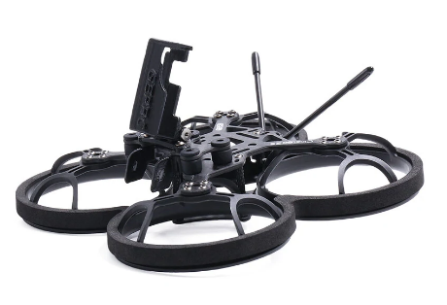

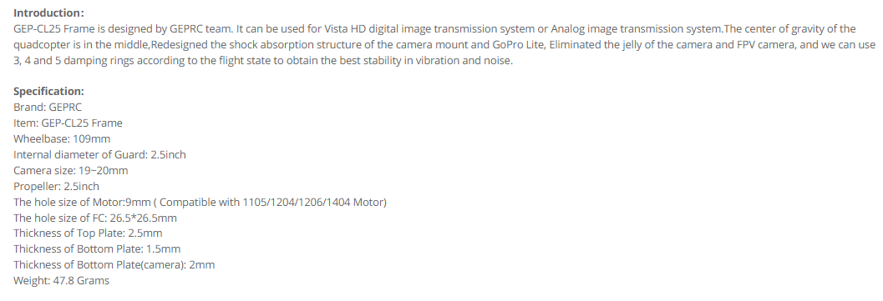
2. FRAME WITH PROPELLER GUARD

Slide 14



3.PROPELLER GUARD

Slide 15
ACTUATORS AND LOCOMOTIONS

Slide 16
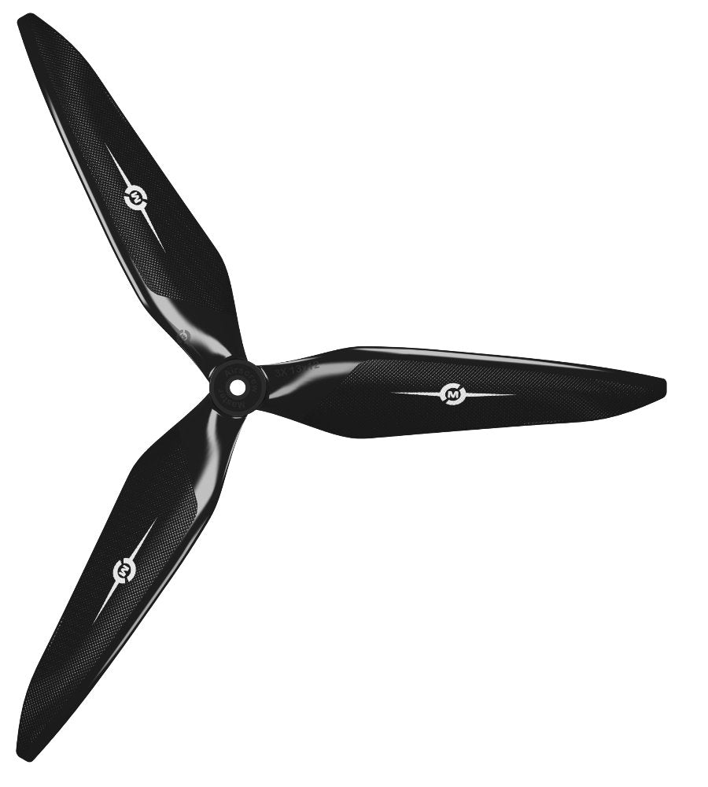


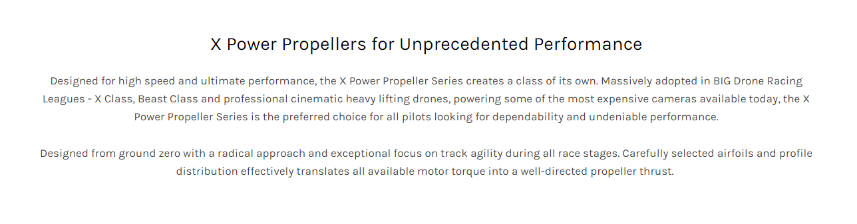
1. PROPELLER

Slide 17
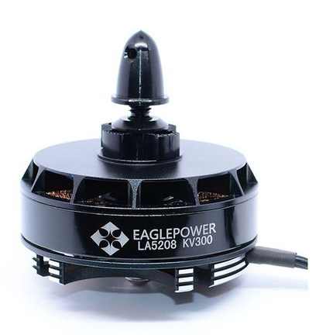


2. DRONE MOTORS

Slide 18
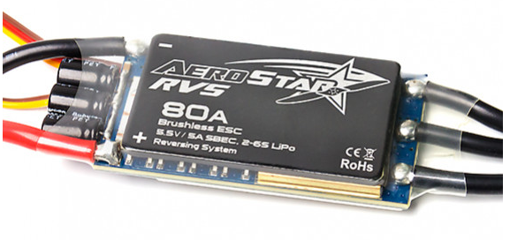
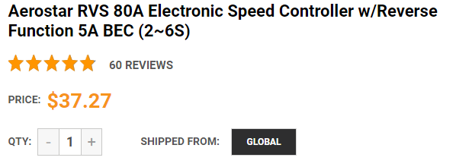
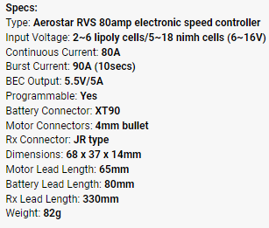
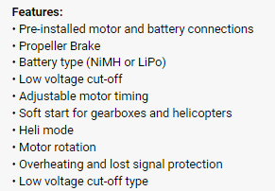
3. MOTOR CONTROLLER

Slide 19
NAVIGATION SYSTEM AND CONTROLLER

Slide 20
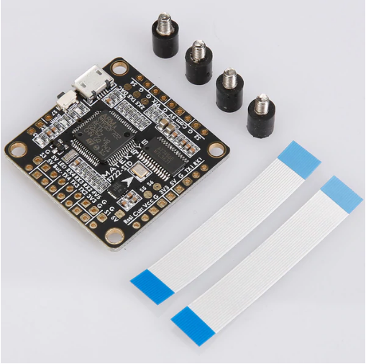
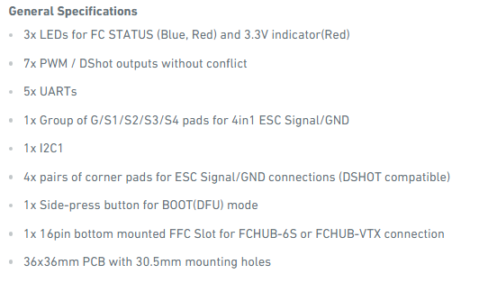
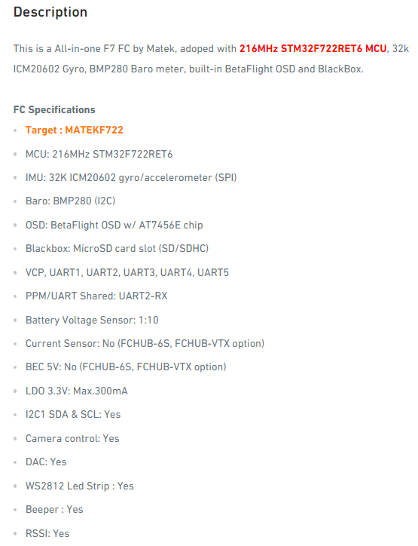

1. FLIGHT CONTROLLER

Slide 21
DATA COLLECTION

Slide 22
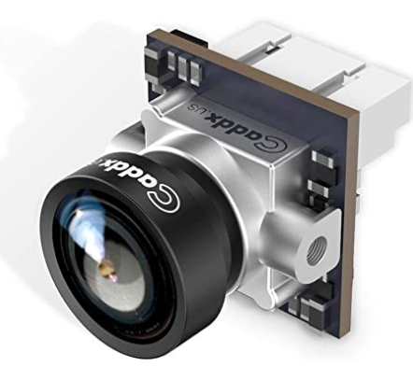


1. CAMERA

Slide 23
DATA TRANSMISSION

Slide 24
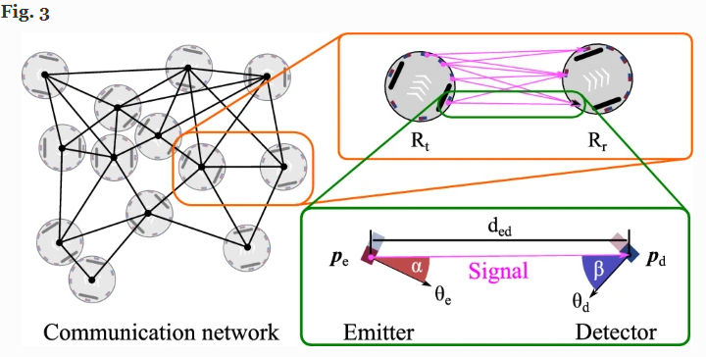
WIRELESS CONNECTIVITY
The e-puck communication network (left) consists of links between pairs of neighboring robots. For each link (top right), the emitters of one robot can transmit a signal that is received by the detectors of the other robot. The signal propagates between emitter–detector pairs (bottom right). Due to occlusion, not all emitter–detector pairs are relevant

Slide 25
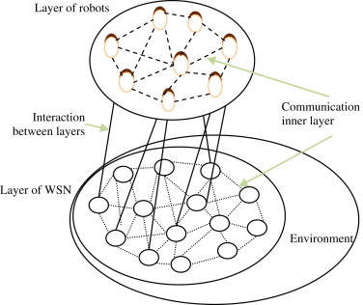

Slide 26
POWER SYSTEM MANAGEMENT

Slide 27




Lithium-Potassium Battery

Slide 28
REFERENCES
https://act.usc.edu/crazyswarm.html
https://learn.g2.com/swarm-robotics

